Slide 1
WEBMONK (COURSE DAY - 13)
Topics covered:
* functional components
* hooks & mostly used two (useState, useEffect)
* Error handling

Slide 2
FUNCTIONAL COMPONENTS

Slide 3

FUNCTIONAL COMPONENTS
* Functional components are some of the more common components that will come across while working in React.
* These are simply JavaScript functions. We can create a functional component to React by writing a JavaScript function.
* These functions may or may not receive data as parameters.
* In the functional Components, the return value is the JSX code to render to the DOM tree.

Slide 4
USESTATE & USEEFFECT HOOKS

Slide 5
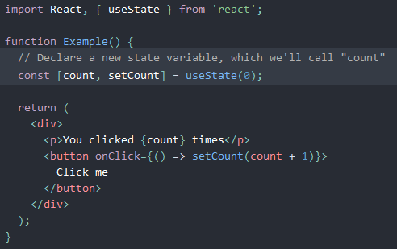
HOOKS
Hooks are a new addition in React 16.8. They let you use state and other React features without writing a class.

Slide 6
USESTATE
it declares a “state variable…This is a way to “preserve” some values between the function calls — useState is a new way to use the exact same capabilities that this.state provides in a class. Normally, variables “disappear” when the function exits but state variables are preserved by React.

Slide 7
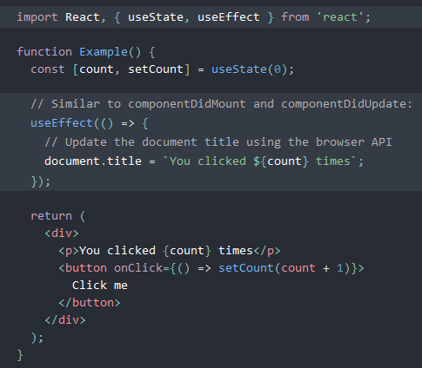
USEEFFECT
think of useEffect Hook as componentDidMount, componentDidUpdate, and componentWillUnmount combined.
useEffect has optional second parameter called dependency: * if no values are provided in the array, it will only evaluate the Hook on mount. [componentDidMount]
* if the array itself is not provided, it will be evaluated every re-render. [componentDidUpdate]
* if array has a value, say [foo] the useEffect Hook will now only be evaluated if the value of foo changes since it is included in the option dependency array. [componentDidUpdate] * if there’s a return statement inside of the useEffect function body. if a function is returned from useEffect, that function is invoked only when the component is removed from the DOM. [componentWillUnmount]

Slide 8
HANDLE ERROR GRACEFULLY

Slide 9
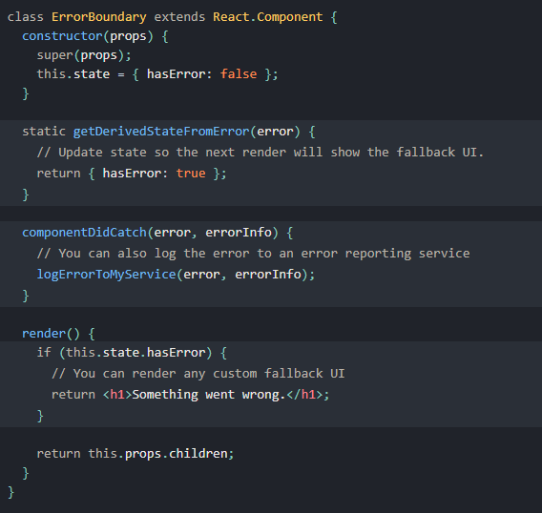
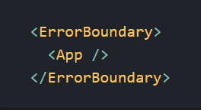
ERROR BOUNDARY
* in the past, JavaScript errors inside components used to corrupt React’s internal state and cause it to emit cryptic errors on next renders. These errors were always caused by an earlier error in the application code, but React did not provide a way to handle them gracefully in components, and could not recover from them.
* error boundaries are React components that catch JavaScript errors anywhere in their child component tree, log those errors, and display a fallback UI instead of the component tree that crashed. Error boundaries catch errors during rendering, in lifecycle methods, and in constructors of the whole tree below them.

